Slide 1
Unit 3 Distributed Database Management Systems

Slide 2
Distributed Databases
A distributed database (DDB) is a collection of multiple, logically interrelated databases distributed over a computer network.
A distributed database management system (D–DBMS) is the software that manages the DDB and provides an access mechanism that makes this distribution transparent to the users.
It consists of loosely coupled sites that share no physical components.

Slide 3
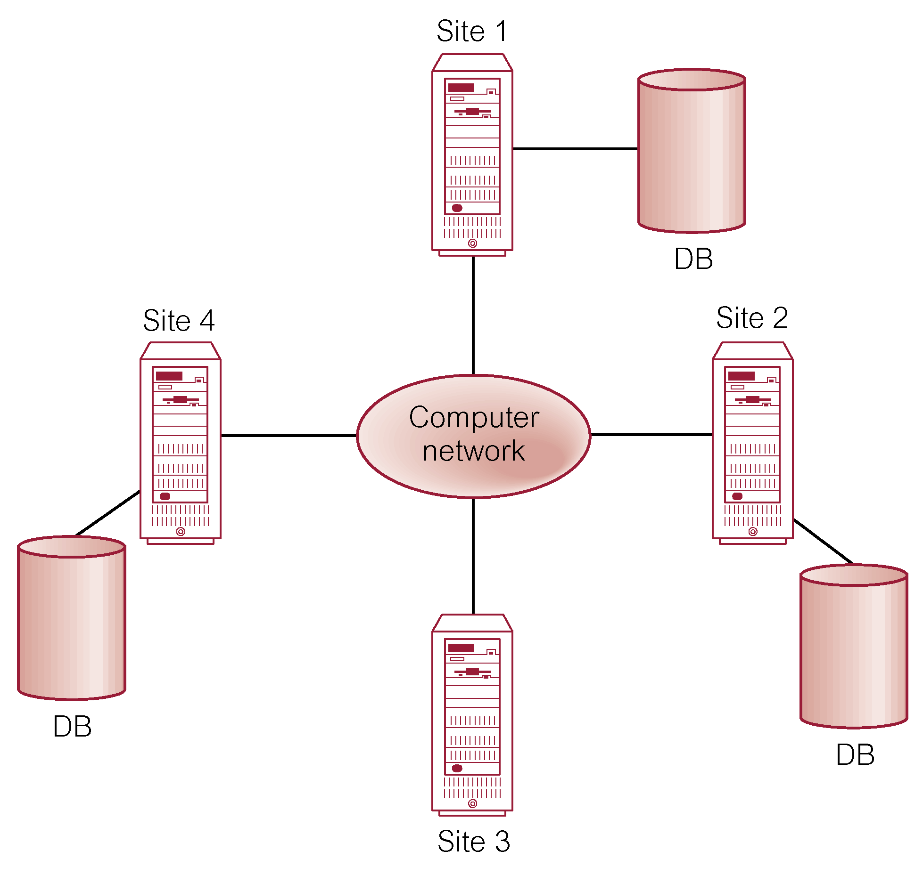
DDBMS

Slide 4
Distributed Database - User View
Distributed Database

Slide 5
Distributed DBMS - Reality
User
Query
DBMS
Software
User
Application
DBMS
Software
DBMS
Software
Communication
Subsystem
User
Application
DBMS
Software
User
Query
DBMS
Software
User
Query

Slide 6
In a homogeneous distributed database
All sites have identical software
Are aware of each other and agree to cooperate in processing user requests.
Each site surrenders part of its autonomy in terms of right to change schemas or software
Appears to user as a single system
In a heterogeneous distributed database
Different sites may use different schemas and software
Difference in schema is a major problem for query processing
Difference in softwrae is a major problem for transaction processing
Sites may not be aware of each other and may provide only

Slide 7
Why Distributed Databases?
Interconnection of existing databases
Incremental growth
Reduced communication overhead
Performance considerations
Reliability and availability
Organizational reasons

Slide 8
Disadvantages of Distributed Databases
Complexity
Cost
Distribution of control
Security
Lack of standards
Difficult to change

Slide 9
Data Distribution in DDBMS
There are 2 important forms of distributed data
1. Data Fragmentation: The decomposition of global relations into fragments is called data fragmentation.
2. Replicated Data : Storing copies of data at multiple sites.

Slide 10
Data Fragmentation
Division of relation r into fragments r₁, r₂, …, r_{n} which contain sufficient information to reconstruct relation r.
Horizontal fragmentation: each tuple of r is assigned to one or more fragments
Vertical fragmentation: the schema for relation r is split into several smaller schemas
All schemas must contain a common candidate key (or superkey) to ensure lossless join property.
A special attribute, the tuple-id attribute may be added to each schema to serve as a candidate key.
Example : relation account with following schema
Account-schema = (branch-name, account-number, balance)

Slide 11
Horizontal Fragmentation example
branch-name
account-number
balance
Hillside
Hillside
Hillside
A-305
A-226
A-155
500
336
62
account₁=σ_{branch-name=“Hillside”}(account)
branch-name
account-number
balance
Valleyview
Valleyview
Valleyview
Valleyview
A-177
A-402
A-408
A-639
205
10000
1123
750
account₂=σ_{branch-name=“Valleyview”}(account)

Slide 12
Vertical Fragmentation example
branch-name
customer-name
tuple-id
Hillside
Hillside
Valleyview
Valleyview
Hillside
Valleyview
Valleyview
Lowman
Camp
Camp
Kahn
Kahn
Kahn
Green
1
2
3
4
5
6
7
deposit₁=Πbranch-name, customer-name, tuple-id(employee-info)
account number
balance
tuple-id
A-305
A-226
A-177
A-402
A-155
A-408
A-639
500
336
205
10000
62
1123
750
1
2
3
4
5
6
7
deposit₂=Πaccount-number, balance, tuple-id(employee-info)

Slide 13
Transparency
Data transparency means the user of DBMS should not be required to know where the data are physically located and how the data can be accessed at the specific site.
It can take 3 forms
Fragmentation transparency
Replication transparency
Location transparency

Slide 14
Reference Architecture of Distributed Databases
Global Schema
Site independent schemas
Fragmentation Schema
Allocation Schema
Local mapping Schema1
Local mapping Schema N
Local schemas may be hetrogeneous
DBMS of site1
DBMS of site2
Local database at site1
Local database at site N

Slide 15
Reference Architecture cont….
Objectives of this architecture are :
Separation of data fragmentation and allocation
Control of redundancy
Independence from local DBMS (heterogeneity)

Slide 16
Allocation of fragments
There are 2 allocation strategies:
Non redundant : In this type of allocation, a ‘best-fit’ approach is used. A measure is associated with each possible allocation and the site with the best measure is selected.
Redundant : This type of allocation introduces complexity in the DBMS design because :
The degree of replication becomes a problem
Modeling read only applications is complicated because the application can access fragments among several alternative sites.

Slide 17
Classification of transactions in distributed databases
Classification on the basis of lifetime:
Short duration
Long duration
Classification on the basis of read/write statements
General transactions
Restricted (Read before write) transactions
Classification on the basis of structure of transactions
Flat transactions
Nested Transactions
Workflows

Slide 18
Client/Server Systems
Client/Server system links a client and server through a network.
The client/server model is based on the distribution of functions between two types of independent and autonomous processes : severs and clients.

Slide 19
Client-Server Architecture
Each component of a client-server system has the role of either client or server
Client: a component that makes requests clients are active initiators of transactions
Server: a component that satisfies requests servers are passive and react to client requests

Slide 20
Centralized / Distributed
The client-server architecture can be thought of as a median between
Centralized processing: computation is performed on a central platform, which is accessed using “dumb” terminals
Distributed processing: computation is performed on platforms located with the user
Centralized
Client / Server
Distributed

Slide 21
Client-Server Architecture
The Web is a client-server system
Web browsers act as clients, and make requests to web servers
Web servers respond to requests with requested information and/or computation
Client
Client
Client
Server
Server
Client
request
Client
Server

Slide 22
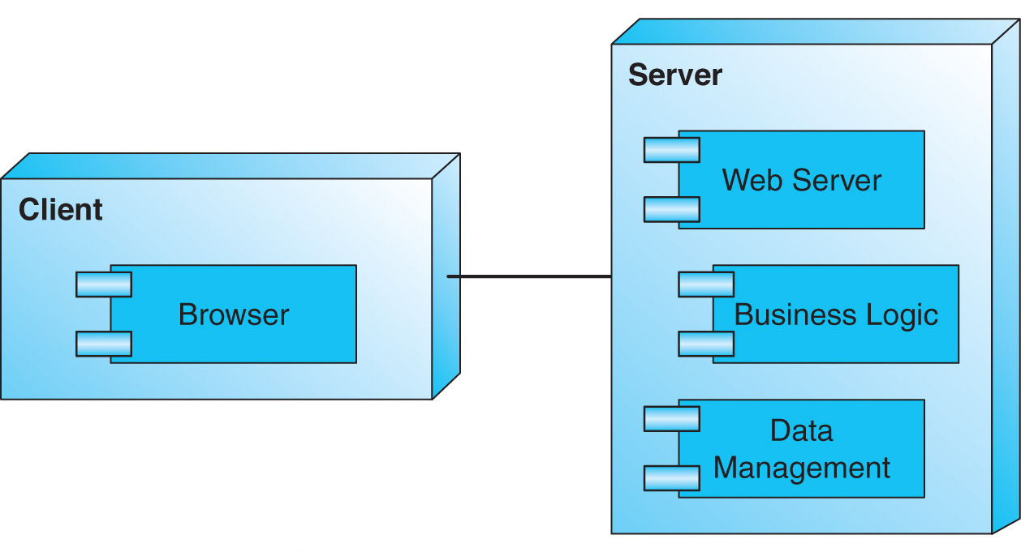
2-Tier C-S Architecture
Tier 1: Client platform, hosting a web browser
Tier 2: server platform, hosting all server software components

Slide 23
2-Tier Characteristics
Advantage:
Inexpensive (single platform)
Communication is faster
Disadvantages
Interdependency (coupling) of components
In two tier architecture application performance will be degrade upon increasing the users.
Cost-ineffective
Typical application
10-100 users
Small company or organization, e.g., law office, medical practice, local non-profit

Slide 24
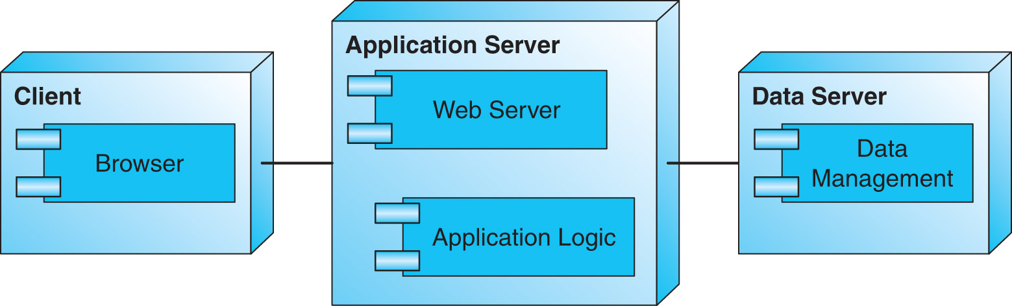
3-Tier C-S Architecture
Tier 3 takes over part of the server function from tier 2, typically data management

Slide 25
3-Tier Characteristics
Advantages
Improved performance, from specialized hardware
Decreased coupling of software components
Improved scalability
Performance – Because the Presentation tier can cache requests, network utilization is minimized, and the load is reduced on the Application and Data tiers.
High degree of flexibility in deployment platform and configuration
Better Re-use
Improve Data Integrity
Improved Security – Client is not direct access to database.
Easy to maintain and modification is bit easy, won’t affect other modules In three tier architecture application performance is good.
Disadvantages
Increase complexity and cost
Typical Application
100-1000 users
Small business or regional organization, e.g., specialty retailer, small college

Slide 26
Roles of client and server
Client
Manage the user interface
Enforce business rules
Process application logic
Generate database requests (SQL)
Transmit database requests to server
Receive results from server
Format results
Server
Accept database request from clients
Process database requests
Format results and transmit to client
Enforce business rules
Perform integrity checking
Maintain database overhead data
Provide concurrent access control
Provide recovery and security services

Slide 27
Advantages & disadvantages
Pro
Applications use client CPUs in parallel
More powerful applications
Network traffic is reduced
Con
Concurrency control
Multiple client OS’s

Slide 28
ODBC
A standard database access method developed by the SQL Access group in 1992.
The goal of ODBC is to make it possible to access any data from any application, regardless of which DBMS is handling the data.
ODBC manages this by inserting a middle layer, called a database driver, between an application and the DBMS. The purpose of this layer is to translate the application's data queries into commands that the DBMS understands.
For this to work, both the application and the DBMS must be ODBC-compliant -- that is, the application must be capable of issuing ODBC commands and the DBMS must be capable of responding to them

Slide 29
ODBC
ODBC functionality is provided by three main components:
the client application
the ODBC Driver Manager
the ODBC driver

Slide 30
JDBC
A Java API that enables Java programs to execute SQL statements. This allows Java programs to interact with any SQL-compliant database.
Since nearly all relational database management systems (DBMSs) support SQL, and because Java itself runs on most platforms, JDBC makes it possible to write a single database application that can run on different platforms and interact with different DBMSs.
JDBC is similar to ODBC, but is designed specifically for Java programs, whereas ODBC is language-independent.
JDBC was developed by JavaSoft, a subsidiary of Sun Microsystems

Slide 31
Using JDBC
The JDBC library includes APIs for each of the tasks commonly associated with database usage:
Making a connection to a database
Creating SQL or MySQL statements
Executing that SQL or MySQL queries in the database
Viewing & Modifying the resulting records

Slide 32
JDBC
DBC is a specification that provides a complete set of interfaces that allows for portable access to an underlying database. Java can be used to write different types of executables, such as:
Java Applications
Java Applets
Java Servlets
Java ServerPages (JSPs)
Enterprise JavaBeans (EJBs)

Slide 33
Components of JDBC
The JDBC API provides the following interfaces and classes:
DriverManager: This class manages a list of database drivers. Matches connection requests from the java application with the proper database driver using communication subprotocol. The first driver that recognizes a certain subprotocol under JDBC will be used to establish a database Connection.
Driver: This interface handles the communications with the database server. You will interact directly with Driver objects very rarely. Instead, you use DriverManager objects, which manages objects of this type. It also abstracts the details associated with working with Driver objects
Connection : This interface with all methods for contacting a database. The connection object represents communication context, i.e., all communication with database is through connection object only.

Slide 34
Components of JDBC
Statement : You use objects created from this interface to submit the SQL statements to the database. Some derived interfaces accept parameters in addition to executing stored procedures.
ResultSet: These objects hold data retrieved from a database after you execute an SQL query using Statement objects. It acts as an iterator to allow you to move through its data.
SQLException: This class handles any errors that occur in a database application.

Slide 35
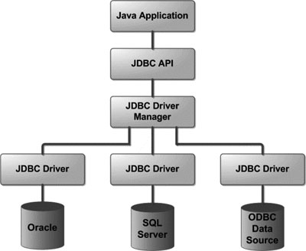
Components of JDBC

Slide 36
ADO
ActiveX Data Objects, Microsoft's newest high-level interface for data objects. ADO is designed to eventually replace Data Access Objects (DAO) and Remote Data Objects (RDO). Unlike RDO and DAO, which are designed only for accessing relational databases, ADO is more general and can be used to access all sorts of different types of data, including web pages, spreadsheets, and other types of documents.
Together with OLE DB and ODBC, ADO is one of the main components of Microsoft's Universal Data Access (UDA) specification, which is designed to provide a consistent way of accessing data regardless of how the data are structured.

Slide 37
Using ADO
The ADO object model is actually quite simple -- there are only six total objects: The Connection object sets up a link between your program and the data source. This object contains all of the necessary configuration information and acts as a gateway for all of the other ADO objects. The Connection object is mandatory -- all implementations of ADO must support it.
Each Connection object may have an associated collection of Error objects. ADO utilizes this collection when the connection returns more than one error message at a time. This collection is optional.
The Command object represents a SQL statement or stored procedure that software executes against the datasource. Use of Command objects is optional -- data can be extracted directly from a Connection object, if desired.
Command objects may have an associated collection of Parameter objects that provide additional information to the data source when executing the command. The Parameter collection is optional.
Each command execution results in a Recordset containing the results of the query. This object is a mandatory part of ADO.
Each Recordset object is composed of a number of Field objects that represent individual columns in the Recordset. This object is a mandatory feature of ADO.

Slide 38
Questions
What is the difference between centralized and distributed environment?
State the advantages nad disadvantages of distributed systems.
Explain the general architecture if Distributed systems.
What are different allocation schemes in distributed databases?
What is fragmentation? Explain the different types of Fragmentation.
Discuss the services provided by ODBC and JDBC tools.

